Slide 1

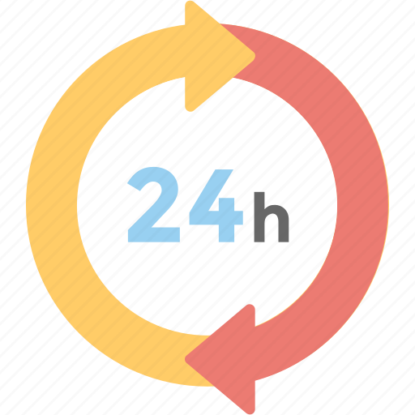
24-HOUR FORECAST
10-11-2022 @ 1200 UTC
Department of Meteorology and Climate Science, KNUST

Slide 2
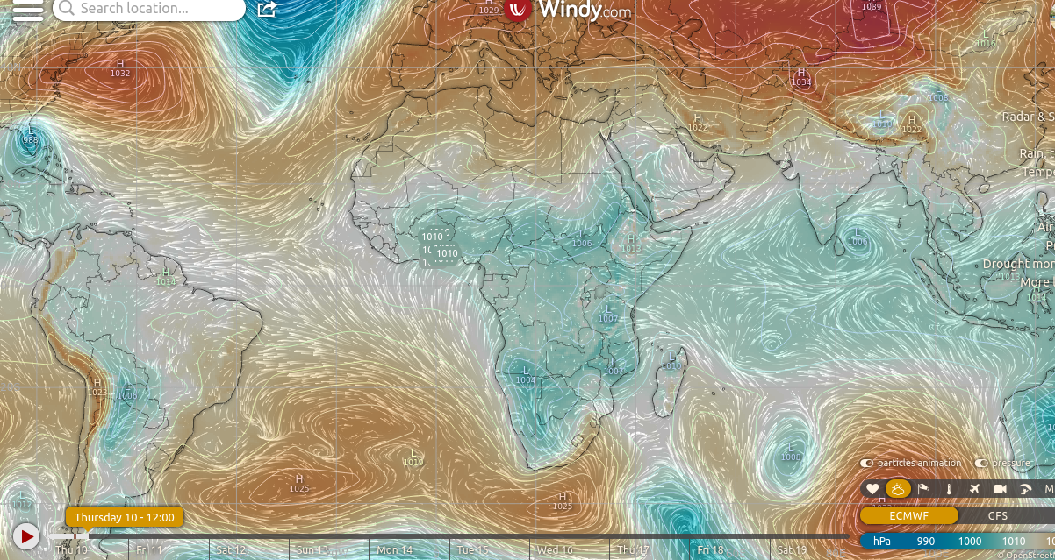
PRESSURE SYSTEM @ 1200 UTC
1020 hPa
1019 hPa

Slide 3
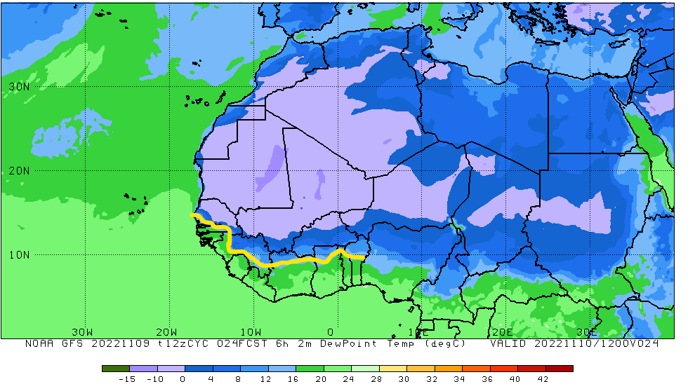
ITD POSITION @ 1200UTC
ITD: 9.5°N

Slide 4
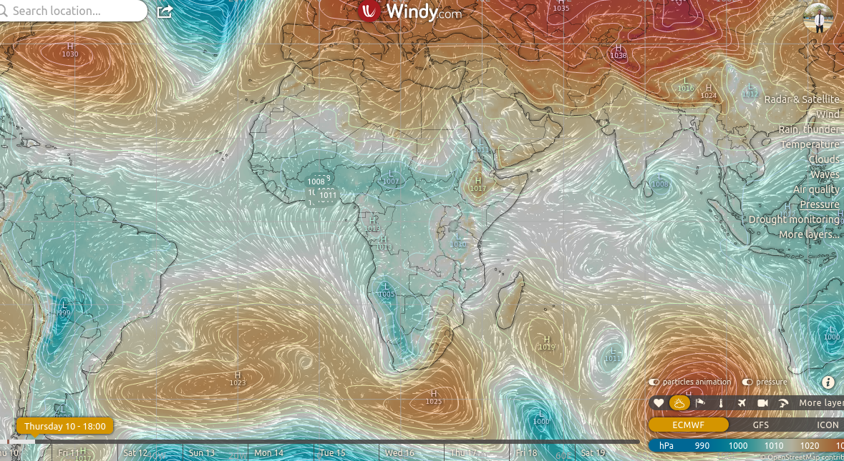
PRESSURE SYSTEM @ 1800 UTC
1018 hPa
1019 hPa

Slide 5
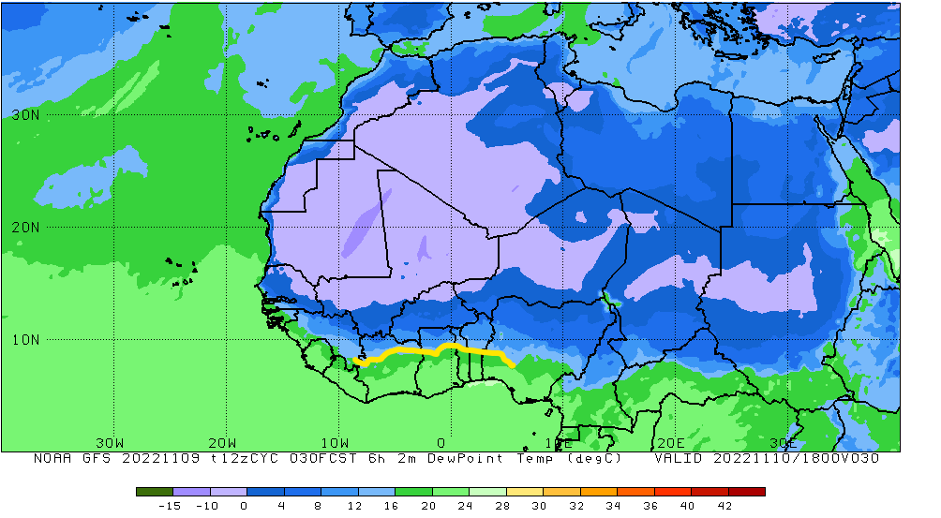
ITD POSITION @1800 UTC
ITD: 9.0°N

Slide 6
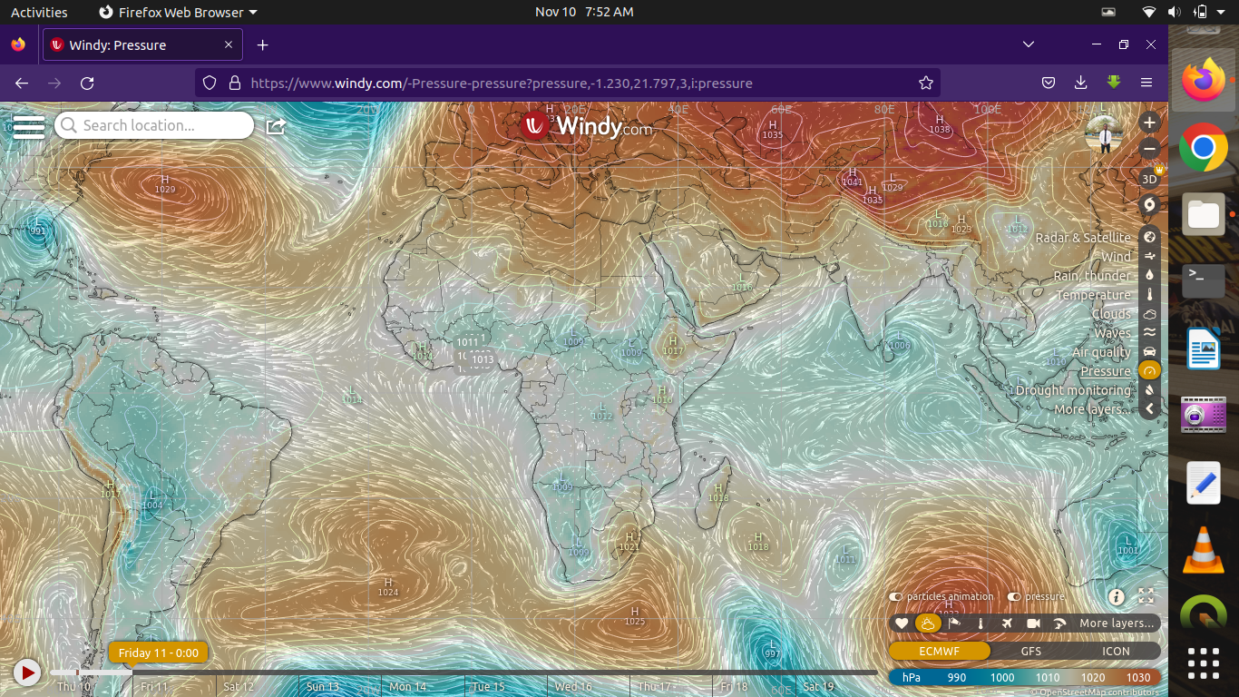
PRESSURE SYSTEM @ 0000 UTC
1019 hPa
1019 hPa

Slide 7
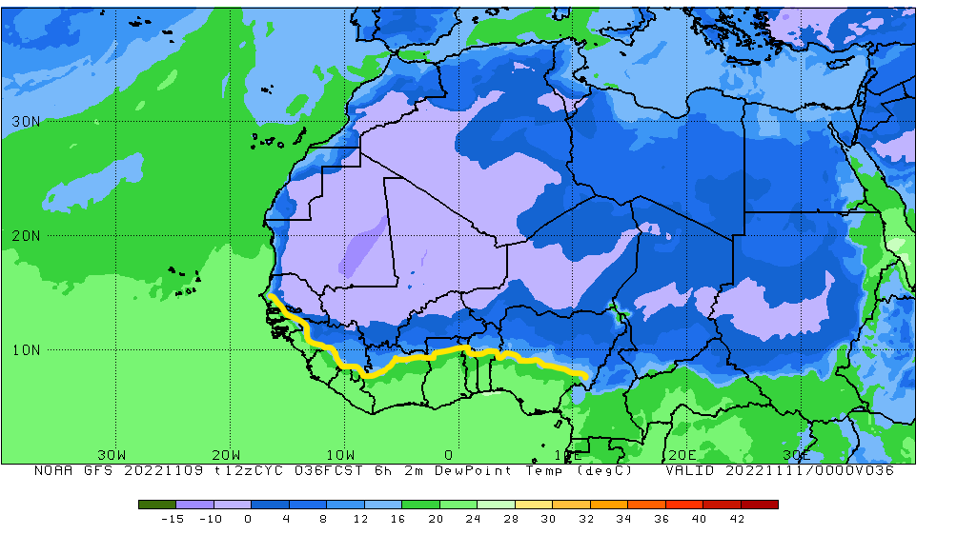
ITD POSITION @ 0000 UTC
ITD: 9.9°N

Slide 8
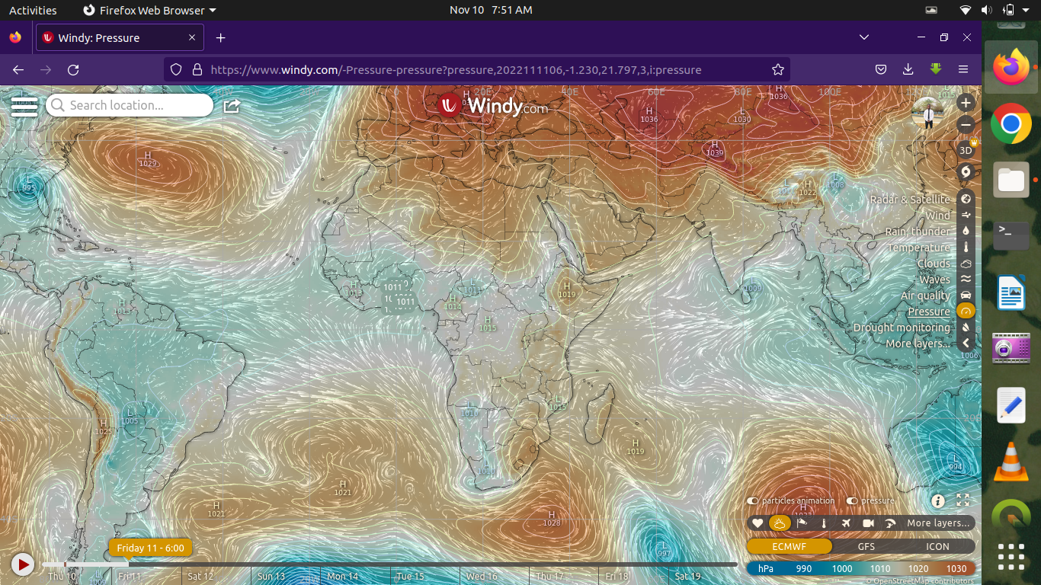
PRESSURE SYSTEM @ 0600 UTC
1016 hPa
1019 hPa

Slide 9
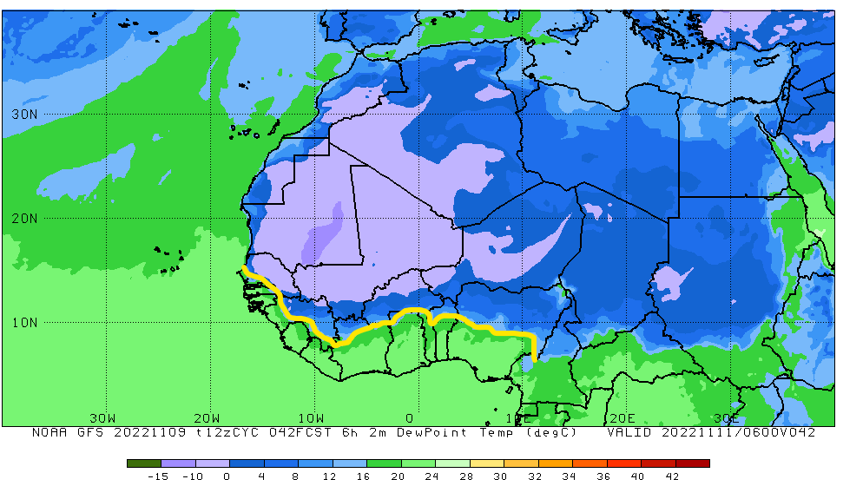
ITD POSITION @ 0600 UTC
ITD: 11.1°N

Slide 10
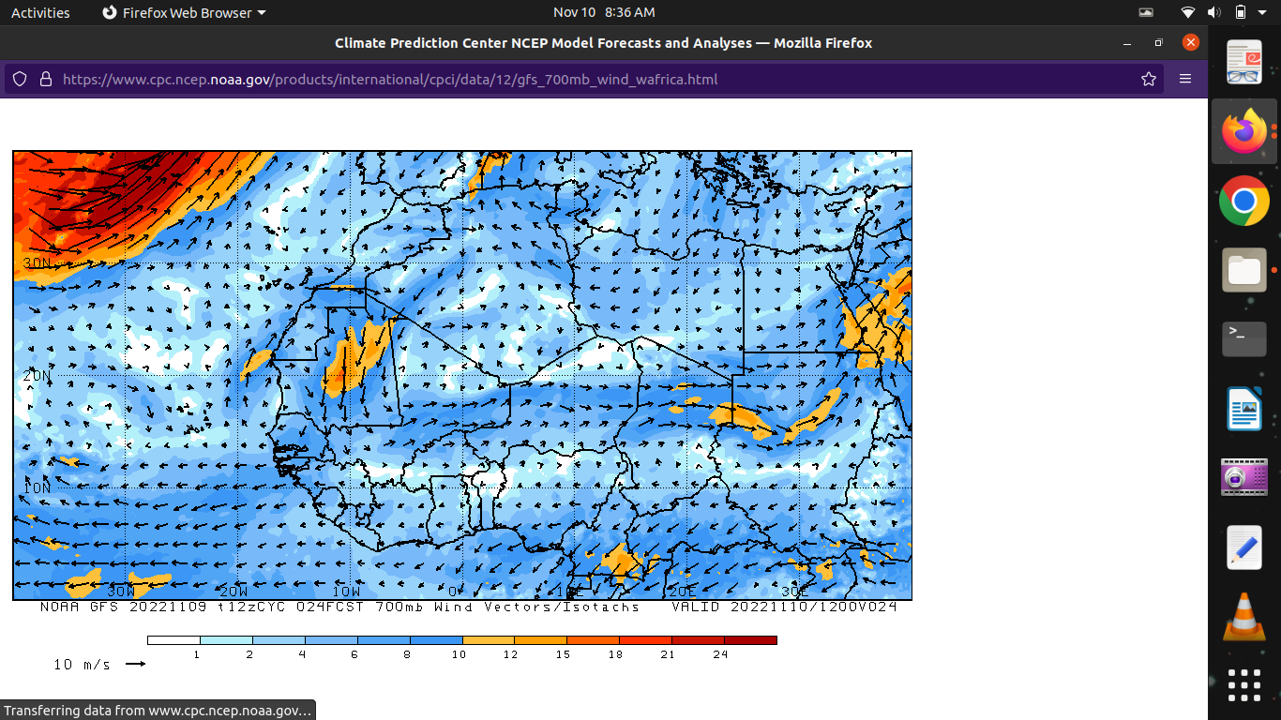
AEJ @ 1200 UTC

Slide 11
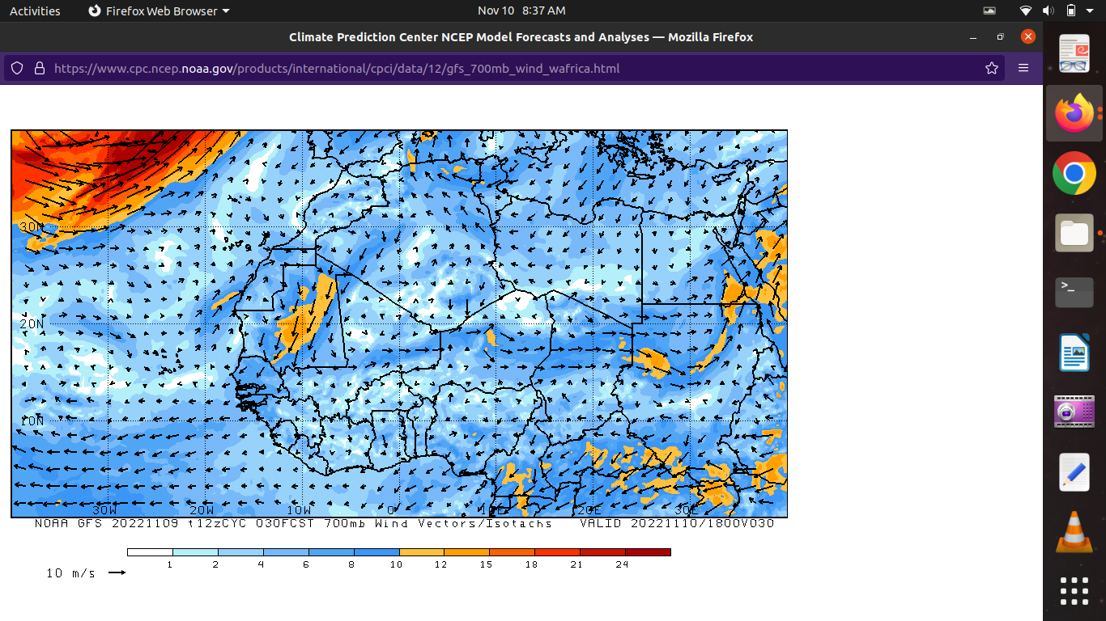
AEJ @ 1800 UTC

Slide 12
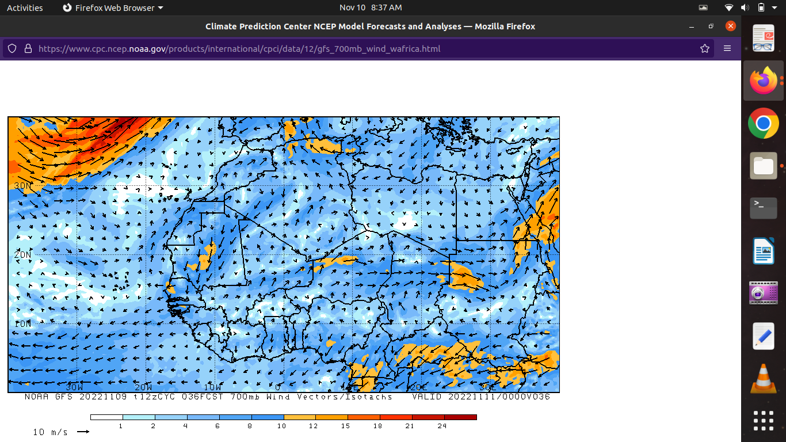
AEJ @ 0000 UTC

Slide 13
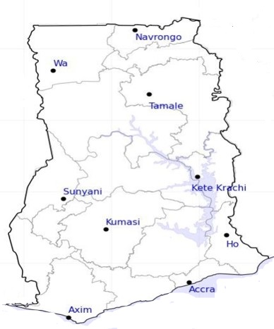
DAY
CAPE
[ J/kg ]
NIGHT
32
0
27
0
148
52
139
52
Damango
Damango
964
1065
529
264
681
401
1094
633
781
643
515
502

Slide 14
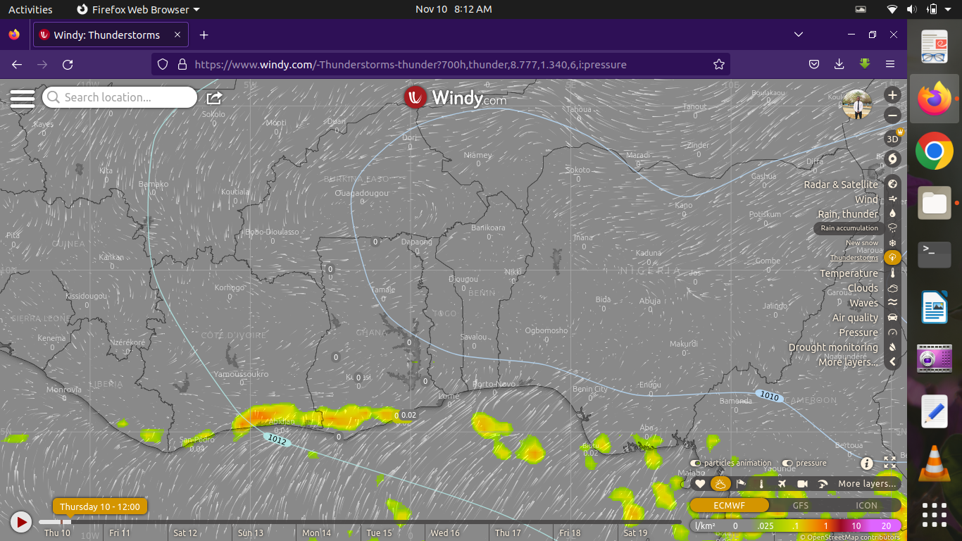
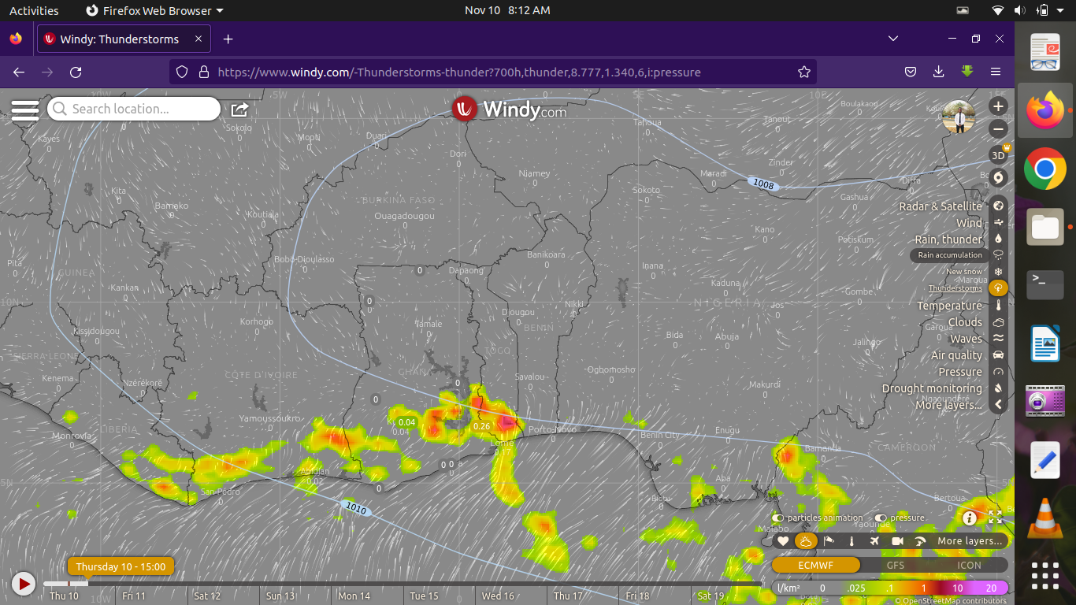
THUNDERSTORM
@ 1200 UTC
@ 1500 UTC

Slide 15
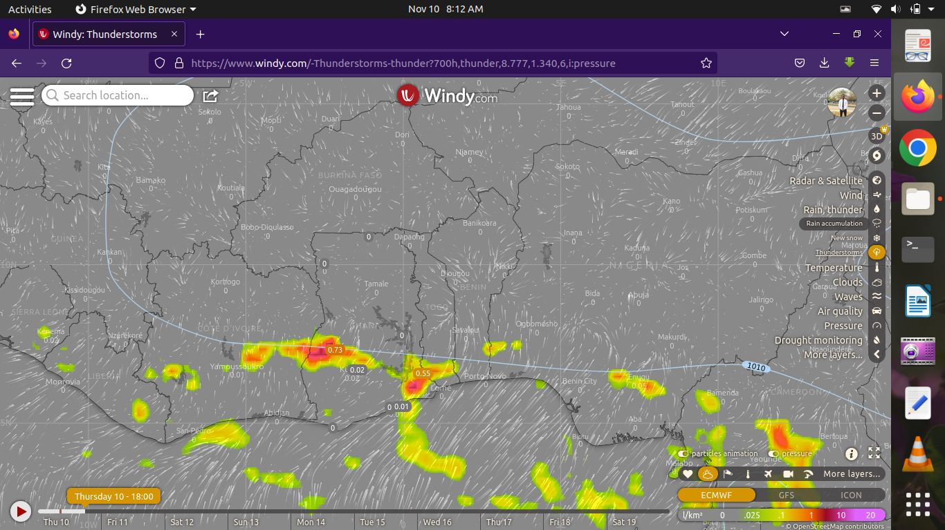
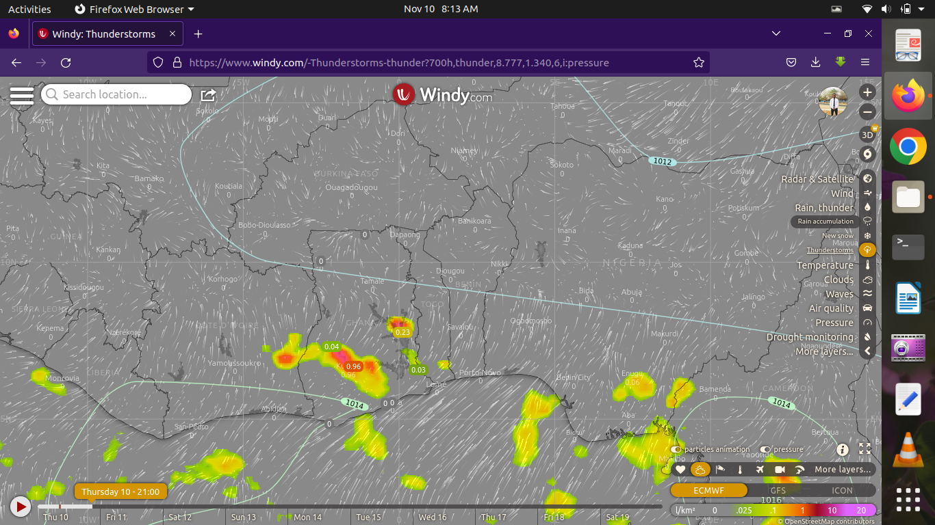
THUNDERSTORM
@ 1800 UTC
@ 2100 UTC

Slide 16

42
24-HOUR FORECAST
10-11-2022 @ 1200 UTC
50
RH AT DAY[%]
55
53
71
78
77
81
80
83

Slide 17
24-HOUR FORECAST
10-11-2022 @ 1200 UTC
54
44
59
RH AT NIGHT
[%]
66
80
95
97
96
87
90

Slide 18
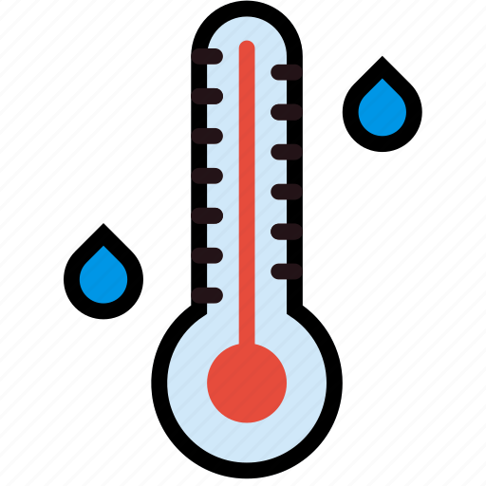
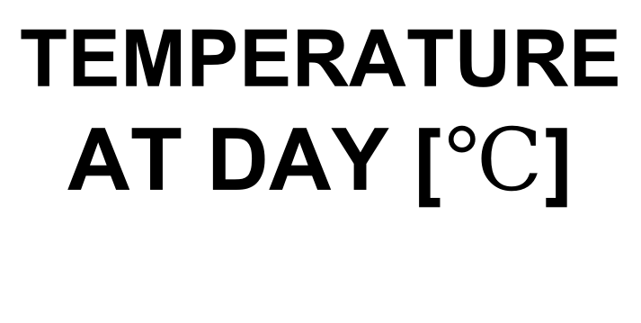
35
24-HOUR FORECAST
10-11-2022 @ 1200 UTC
34
TEMPERATURE AT DAY [$℃$]
34
34
31
31
29
28
28
26

Slide 19
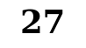
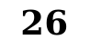
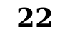

28
24-HOUR FORECAST
10-11-2022 @ 1200 UTC
27
21
TEMPERATURE AT NIGHT[$℃$]
$$27$$
28
23
23
$$22$$
26
$$26$$

Slide 20

GENERAL OUTLOOK
24-HOUR FORECAST
10-11-2022 @ 1200 UTC
PROBABILITY OF RAINS
30-60%

Slide 21

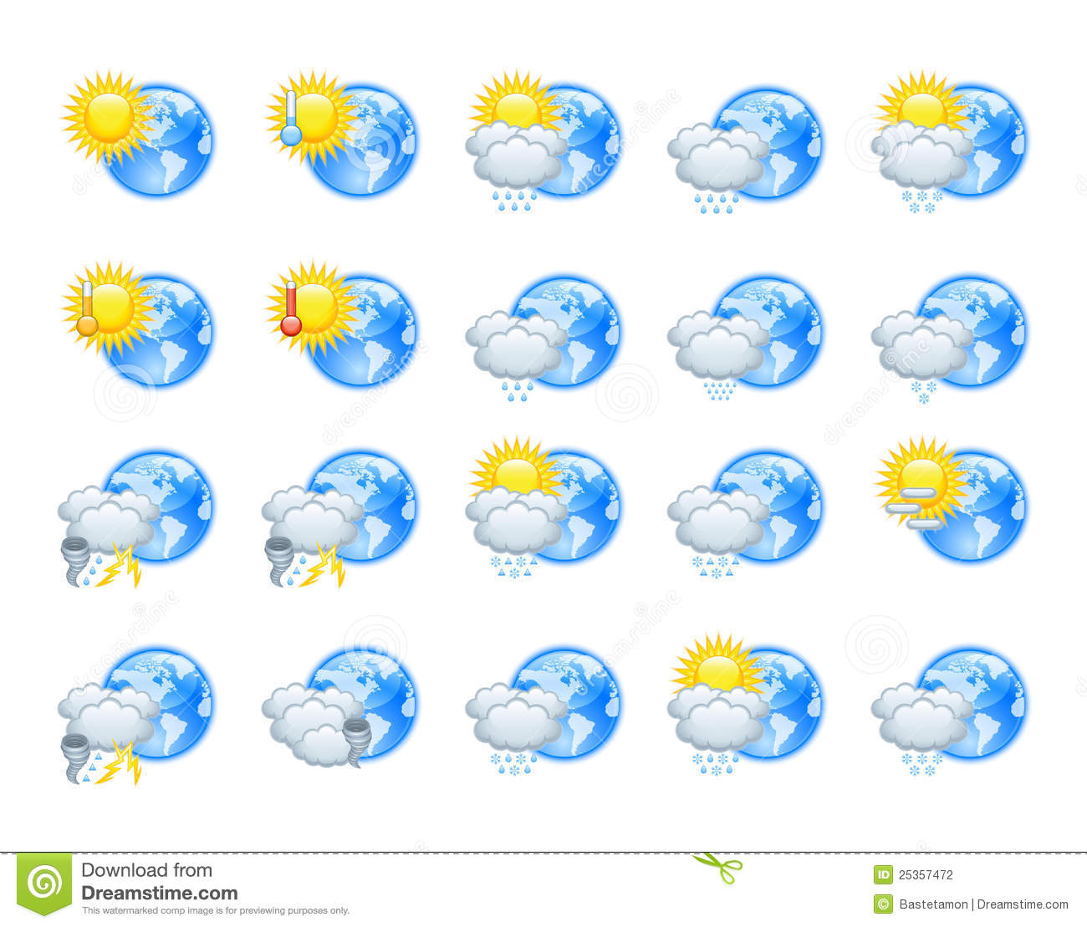





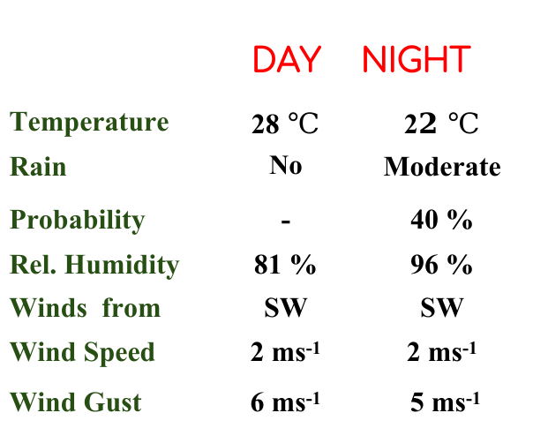
KNUST WEATHER FORECAST
24-HOUR FORECAST
10-11-2022 @ 1200 UTC
Rain
Wind
Dust
.
Forecast Summary (KUMASI)
 | DAY | NIGHT
Temperature | 28 $℃$ | 2$2 ℃$
Rain | No | Moderate
Probability | - | 40 %
Rel. Humidity | 81 % | 96 %
Winds from | SW | SW
Wind Speed | 2 ms⁻¹ | 2 ms⁻¹
Wind Gust | 6 ms⁻¹ | 5 ms⁻¹
Low risk
Be aware
Be Prepared
Take Action
Department of Meteorology and Climate Science, CoS.
SUNSET: 05:46 PM SUNRISE: 5:55 AM
POWERED BY:

Slide 22


